Slide 1
4 PLAYER CHESS

Slide 2
RULES

Slide 3
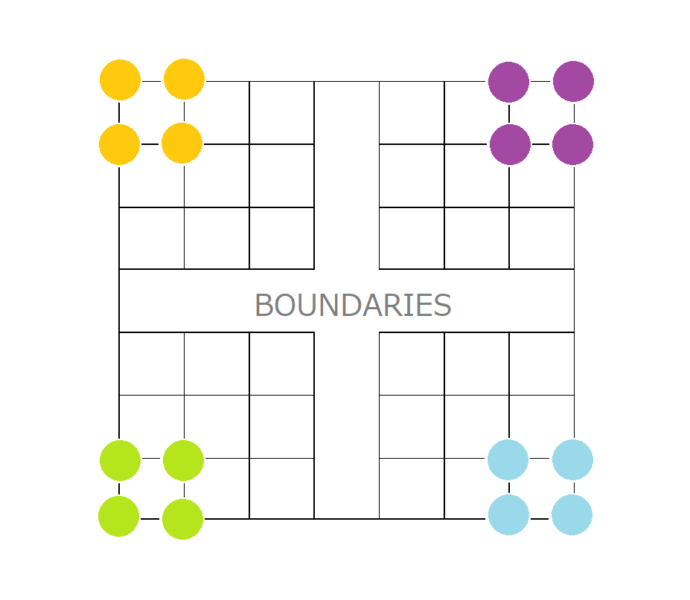
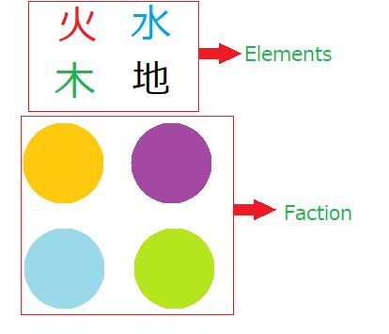
CHESS/FACTIONS/MAP
Pieces
Field

Slide 4
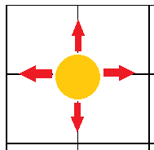
MOVE RULES
Move Rules:
Chess pieces’ move:

Slide 5
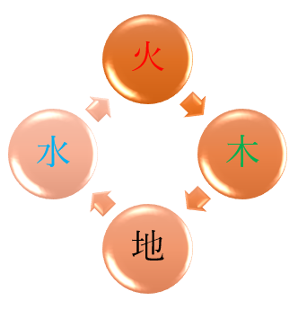
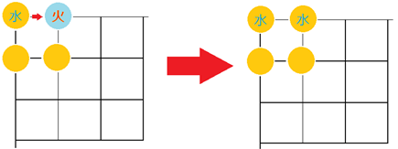
COMBAT RULES
Elements’ relationship:
Attack Weaker Element:

Slide 6
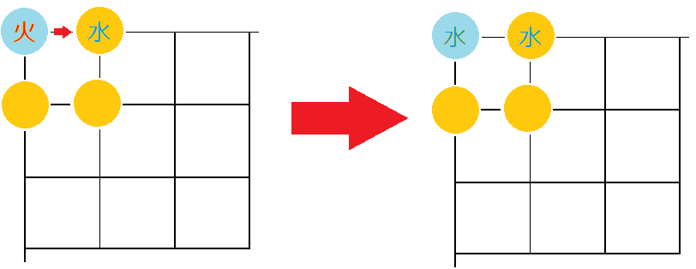
COMBAT RULES
Attack stronger element:
Attack same element:
Both die (both player lose 1 chess)
Attack opposite element(i.e.地 vs 火):
Nothing happens

Slide 7
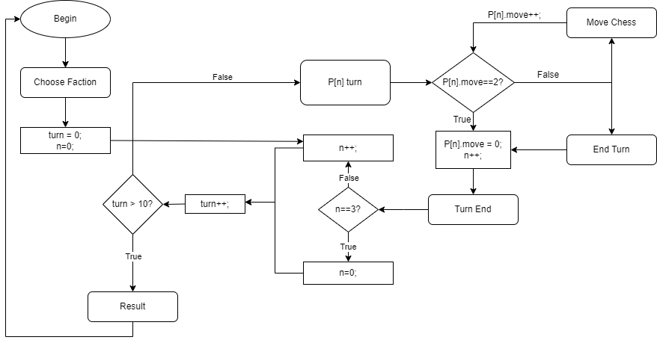
GAME PLAY
Game Flow:

Slide 8
GAME PLAY
Winning condition:
After round 10: Have the most faction’s chesses

